Slide 1
Hack Assembler
CSc 112.1
Project 06
Nand2tetris.org
Michael June Arañas
Loiue Kert Basay

Slide 2
What is Hack Assembler?
Hack assembler - a program that generates binary code that can run as is on the hardware

Slide 3
Objectives
Make a Program that translate a .asm file to .hack file or simply an Assembler
NOTE:
.asm is an Assembly Language file
.hack is a Binary Code file each line of the text lines in the file contains a sequence of 16 0’s and 1’s ASCII characters. Coding a 16-bit machine language instruction.

Slide 4
Materials
Of course, in this project we will use a PC or a laptop to code the Hack Assembler
We choose Python language to do this so
Particularly 3.1 version of python

Slide 5
Procedure
To make the Hack Assembler there are 4 modules to make:
1.) Symbol Table Module (symbolTable.py) which contains the predefined/initialized values using the dictionary function of Python. The dictionary (dict) stores the RAM/ROM addresses for Variable/Label symbols.
2.) Code Module (Code.py) which contains 3 functions.
dest(#a string parameter here) which returns 3 bits in binary code of the dest mnemonic.
comp(#a string parameter here) which returns 7 bits in binary code of the comp mnemonic.
jump(#a string parameter here) which returns 3 bits in binary code of the jump mnemonic

Slide 6
symbolTable.py
symbol_Table = {
'SP' : 0,
'LCL' : 1,
'ARG' : 2,
'THIS' : 3,
'THAT' : 4,
'R0' : 0,
'R1' : 1,
'R2' : 2,
'R3' : 3,
'R4' : 4,
'R5' : 5,
'R6' : 6,
'R7' : 7,
'R8' : 8,
'R9' : 9,
'R10' : 10,
'R11' : 11,
'R12' : 12,
'R13' : 13,
'R14' : 14,
'R15' : 15,
'SCREEN' : 16384,
'KBD' : 24576 }
def addEntry(symbol):
symbol is dict
symbol_Table.update(symbol)
def contains(symbol):
return symbol in symbol_Table
def getAddress(symbol):
if symbol in symbol_Table:
return symbol_Table.get(symbol)
else:
return -1

Slide 7
Code.py
def dest(destString):
destination = {
None : '000',
'M' : '001',
'D' : '010',
'MD' : '011',
'A' : '100',
'AM' : '101',
'AD' : '110',
'AMD' : '111' }
return destination[destString]
def comp(cmpString):
compute = {
'0' : '0101010',
'1' : '0111111',
'-1' : '0111010',
'D' : '0001100',
'A' : '0110000',
'!D' : '0001101',
'!A' : '0110001',
'-D' : '0001111',
'-A' : '0110011',
'D+1' : '0011111',
'A+1' : '0110111',
'D-1' : '0001110',
'A-1' : '0110010',
'D+A' : '0000010',

Slide 8
Code.py continuation
'D-A' : '0010011',
'A-D' : '0000111',
'D&A' : '0000000',
'D|A' : '0010101',
'M' : '1110000',
'!M' : '1110001',
'-M' : '1110011',
'M+1' : '1110111',
'M-1' : '1110010',
'D+M' : '1000010',
'D-M' : '1010011',
'M-D' : '1000111',
'D&M' : '1000000',
'D|M' : '1010101', }
return compute[cmpString]
def jmp(jmpString):
jump = {
None : '000',
'JGT' : '001',
'JEQ' : '010',
'JGE' : '011',
'JLT' : '100',
'JNE' : '101',
'JLE' : '110',
'JMP' : '111' }
return jump[jmpString]

Slide 9
Continuation…….
3.) Parser Module (commandParse.py) the most complicated module in the program.
In our program, we decided not to follow the API.
First, we create a commandType class to determine what type of the current command is
Next, a commandReader function which will read/parse line by line code in the .asm file.
Finally, a commandWriter function which translate the line by line code of a .asm file into a .hack file.

Slide 10
commandParser.py
import Code # Imports the required functions for a C_Command
class commandType(object):
def __init__(self, cmd_string):
if '@' in cmd_string: #The ‘@’ defines an A_Command
self.cmd_string = cmd_string[1:] #Pre-emptively remove '@', leaving only address or variable symbol
self.type = 'A_Command'
elif any(symbol in cmd_string for symbol in ['=', ';']): # The '=' or ';' defines C_Command
self.cmd_string = cmd_string # Whole string becomes the C_Command
self.type = 'C_Command'
def commandReader(lines, symbol_Table):
commands = []
for line in lines: # Cycle through all lines in .asm file
line = line.strip() # remove whitespace/new lines on ends of string
line = line.replace(' ', '') # remove spaces within string
if '//' in line: # Identify comments
index = line.index('//') # Finds the start of comments
line = line[:index] # Removes comment from current line
if line == '': # If line is empty (could have been empty to begin with or after having comments removed)
continue # ...go to the next item in the for loop
elif line[0] == '(': # If the line starts with a (, then this line corresponds to a Label Symbol L_Command
label = line.strip('()') # Grab the label
symbol_Table[label] = len(commands) # Insert the label in the symbol table w/ corresponding ROM line
# which is equal to the number of commands in parsed_lines so far.
elif line[0] == '@': # If the line starts with a '@', then this line corresponds to an A_Command
label = line[1:] # Grab address label (either a number or a Label Symbol)
commands.append(commandType(line)) # Add an instance of the command class to the commands list
else: # Otherwise, this line is a C_Command
commands.append(commandType(line)) # Add an instance of the command class to the commands list
return commands

Slide 11
commandParser.py continuation…
def commandWriter(commands, hackFile, symbol_Table, varSymStart):
for commandType in commands: # For all commands
if commandType.type == 'A_Command': # In the case of A_Commands
label = commandType.cmd_string # Grab the A_Command itself
if (not label.isdigit()) and (label not in symbol_Table.keys()): # Check if the A_Command is a variable label symbol_Table[label] = varSymStart # Enter new Variable Label into Symbol Table
varSymStart = var_sym_start + 1 # Set memory location of next Variable Symbol
if commandType.cmd_string in symbol_Table.keys(): # If the A_Command is a Variable Symbol for a RAM address
address = int(symbol_Table[commandType.cmd_string]) # Grab the corresponding decimal address
else:
address = int(commandType.cmd_string) # Otherwise, get the decimal address explicitly from the A_Command
address = bin(address)[2:] # Turn the address from decimal to binary
address = (16-len(address))*'0' + address # Pad the binary address with zeros so it is 16 bits
print(address)
hackFile.write(address + '\n') # Write the address specified by the A_Command to the .hack file
elif commandType.type == 'C_Command': # In the case of a C_Command
if '=' in commandType.cmd_string: # If there is an equal sign in the command:
dest = commandType.cmd_string.partition('=')[0] # Get the dest bits
cmp = commandType.cmd_string.partition('=')[2] # Get the cmp bits
jmp = None # Get the jmp bits (note that when there is an = in the C_Command, the jump bits are '000'
elif ';' in commandType.cmd_string: # Same thing if there is an ';' in the command, except the dest bits are '000'
dest = None
cmp = commandType.cmd_string.partition(';')[0]
jmp = commandType.cmd_string.partition(';')[2]
print('111' + Code.cmp(cmp) + Code.dest(dest) + Code.jmp(jmp))
hackFile.write('111' + Code.cmp(cmp) + Code.dest(dest) + Code.jmp(jmp) + '\n') # Write the C_Command to the .hack file.

Slide 12
Continuation……
3.) The main program (assembler.py) or the driver program.

Slide 13
Assembler.py (main program)
import commandParser, time, symbolTable
from time import clock
from symbolTable import symbol_Table
varSymStart = 16 # Set a counter defining where memory allocation starts
asmFileName = input('Enter the name of the .asm file to process: ') #assembly filename
asm = open(asmFileName + '.asm') # open .asm file
lines = asm.readlines() # get lines from .asm file
# turn lines into command objects using parser2's parse function
commands = commandParser.commandReader(lines, symbol_Table)
# Open the .hack file for writing
hackFile = open(asmFileName+ '1' + '.hack', 'w')
start = time.clock() #start computing the running time of the function
# Send list of commands to parser to write to .hack file
commandParser.commandWriter(commands, hackFile, symbol_Table, varSymStart )
elapsed = (time.clock() - start) #elapsed time
print(elapsed, 'seconds') #prints the time elapsed
hackFile.close() # Close the .hack file.
print('Done')

Slide 14
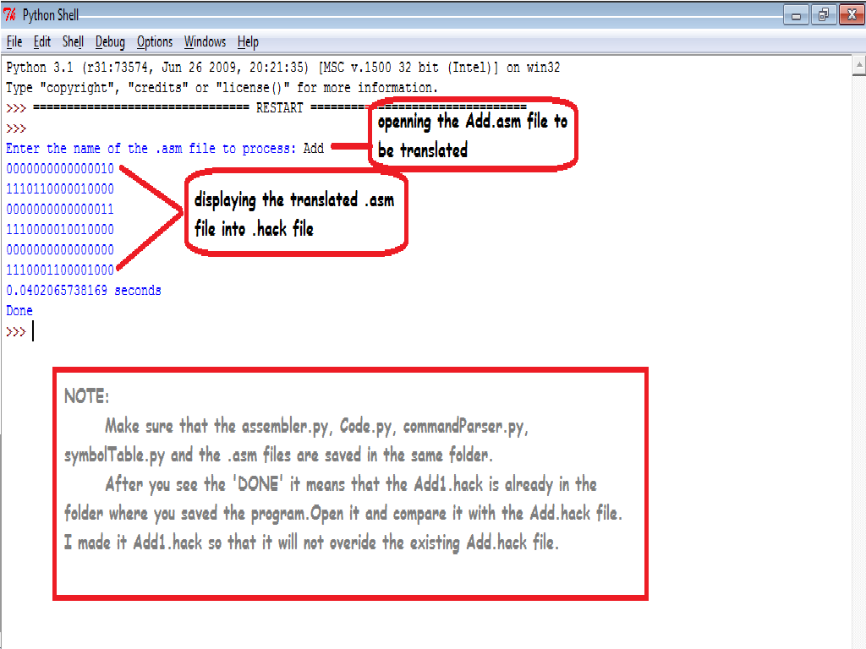
Here are some snapshots of the assembler:

Slide 15
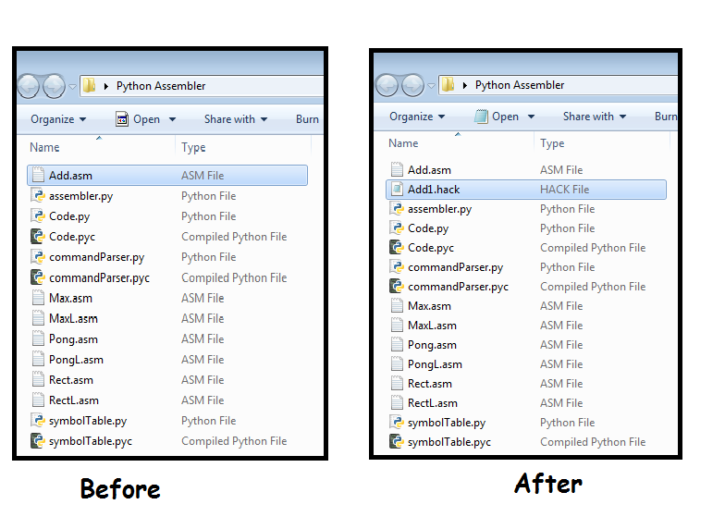
Before and After running the compiler…

Slide 16
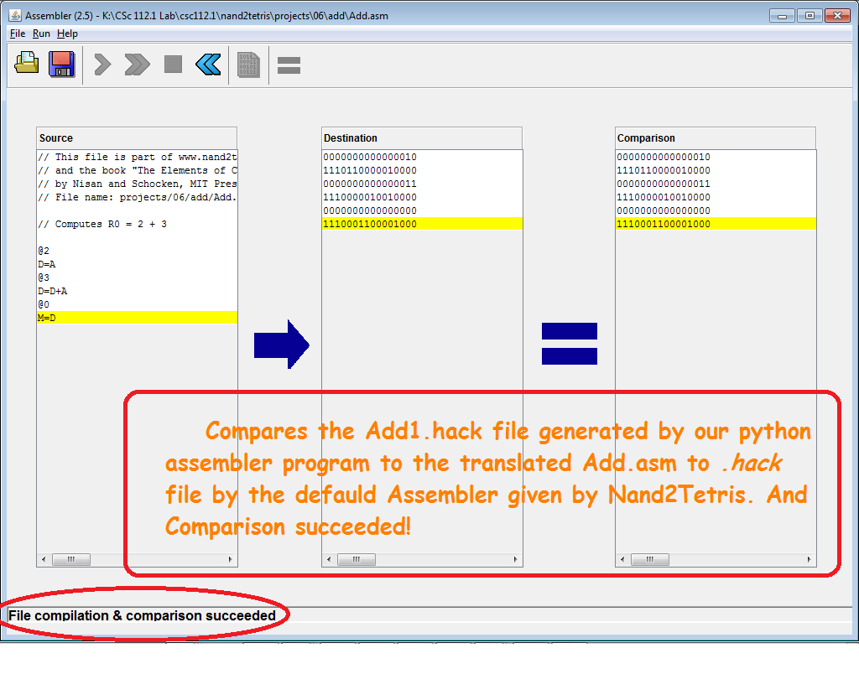
Conclusion
Example Add.asm file

